Slide 1

Welcome to beginners Arrernte

Slide 2
Course aims
Students will:
be able to communicate using everyday sentences in Arrernte
learn about where Arrernte language is spoken and about Arandic dialects
understand about the Arrernte sound system
be able to produce some Arrernte sounds
learn some basic Arrernte grammar
learn to sing Arrernte songs
become familiar with available resources

Slide 3

Werte
Iwenhe arlte lyete?
Apmwerrke Saturday aneke.
Ingwenthe Monday anetyenhe.
Iwenhe ingwenthe anetyenhe?
Arlte lyete Sunday.
Iwenhe apmwerrke aneke?

Slide 4
Introduction Activity
Angwenhe atyewe ngkwenhe?
Arritnye atyenhe …. ​
Iwenhe arritnye ngkwenhe?
Atyewe atyenhe ….

Slide 5
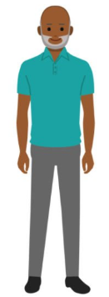
Akeme-irremele tnaye!

Slide 6
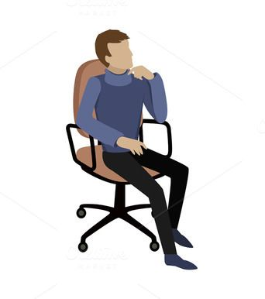
Arrerne-alhaye!

Slide 7
Introductions
Unte nthenhe arenye? | Where are you from?
Ayenge (name of place)-arenye. | I am from …..
Unte nthenhe-le urrkepeme? | Where do you work?
Ayenge (name of workplace)-le urrkepeme. | I work at …. .

Slide 8
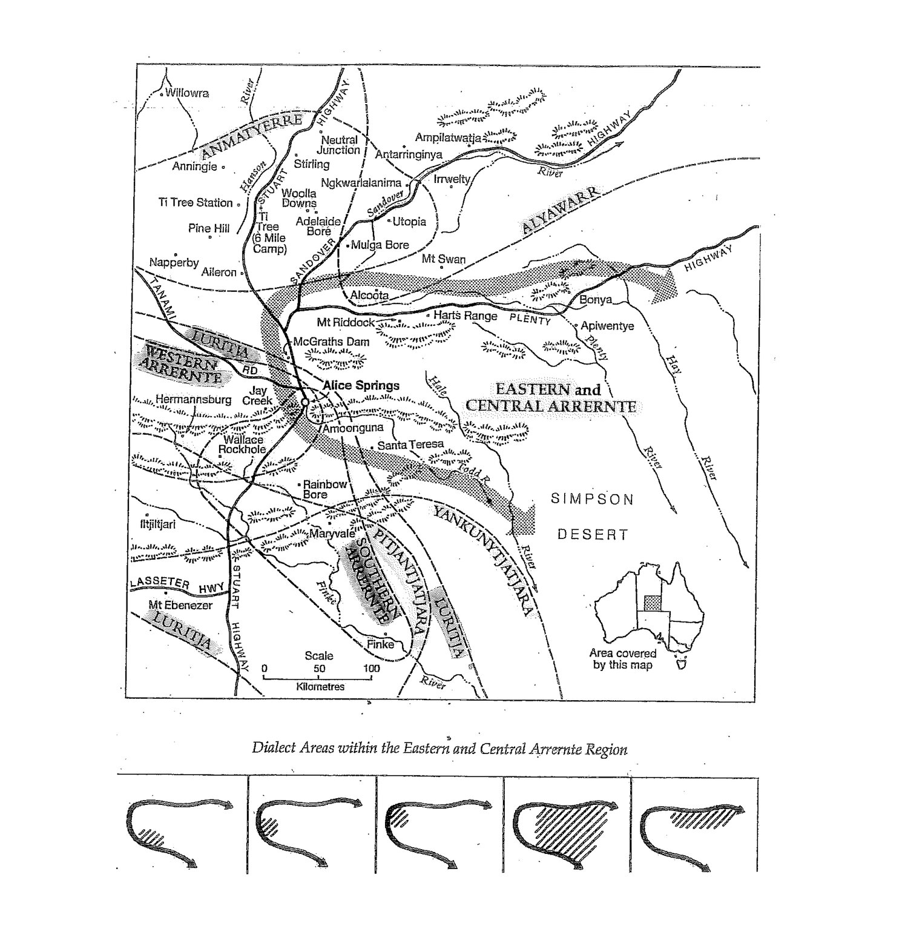
Introduction to Central Australian Languages
Rather than distinct languages, many "languages" in Central Australia are considered dialects within a larger language family, with significant overlap in vocabulary and grammar.
Eastern and Central Arrernte are considered to be strong languages with about 1500 – 2000 fluent speakers.
Arandic languages are under considerable pressure from English, and some of the languages are at risk with some only having one (older) generation of fluent speakers.
Arandic languages include Anmatyerr, Alyawarr, Kaytetye, Western Arrernte, Pertame, Lower Arrernte, Central and Eastern Arrernte dialects (which are closely related varieties of a language.

Slide 9
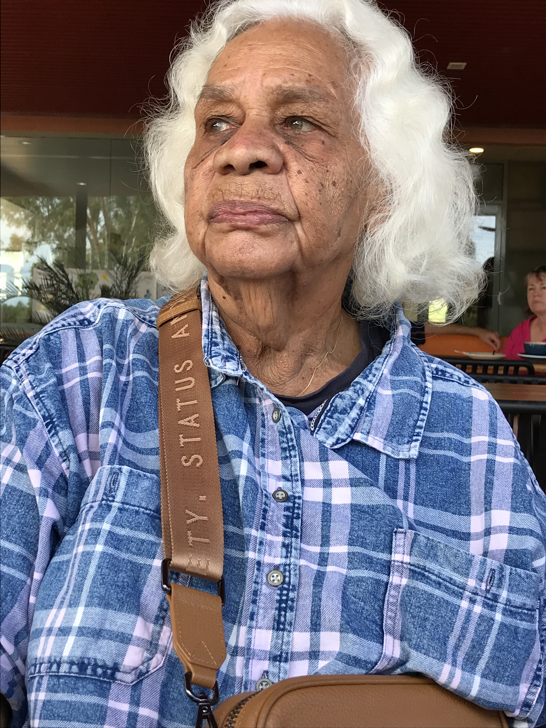
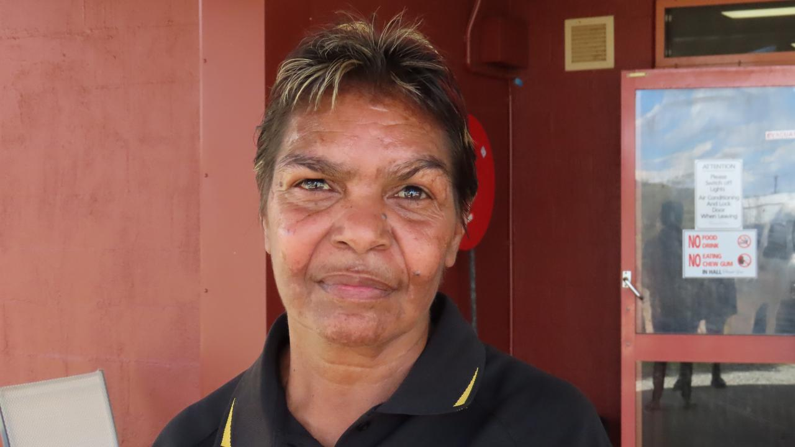
Ikngerre-ipenhe (Eastern) Arrernte
Central Arrernte
boomerang | ilye | alye
thorny devil | unyerre | ankerrthe
pigweed | alyawe | irlparpe

Slide 10
Linguistic Alert – Arrernte Sounds
Many Arrernte sounds don’t match up very closely with English sounds
The spelling system used today was developed in the 1970s
Only a few Arrernte people can read and write in their own language, however with continued development of language programs in schools the use of the writing system is growing.
"The Common Arandic Approach" – the set of principles used to write Central and Eastern Arrernte was agreed to by a large meeting of Arrernte people in 1998.

Slide 11
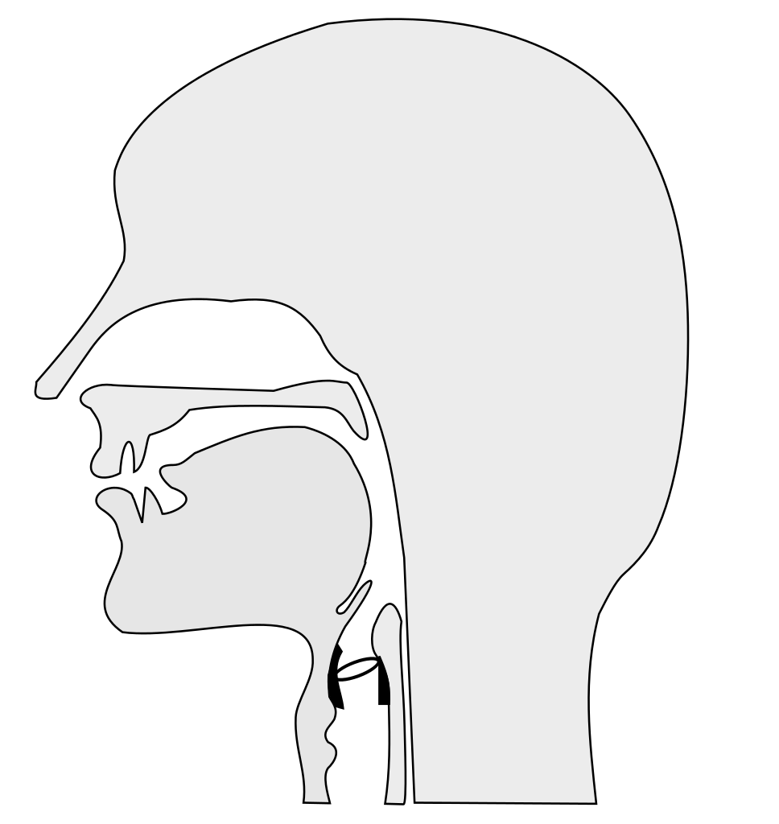
How sounds are classified – linguistic terminology ‘metalanguage’
Metalanguage - language about language – can be
helpful in understanding the sound system of a language.
Sounds are organised by the:
manner of articulation and
place of articulation.
This refers to how the air that passes through the
nose and mouth is intercepted on its way by the
tongue, teeth and roof of the mouth.
Place of articulation - front to back of mouth
Manner of articulation – eg. stops, nasals, laterals
Ridge behind teeth
Nose
Airway
to nose
Lips
Tongue
Teeth
Vocal
cords
Larynx
or voicebox
Airway to and from lungs
Notes:
Terminology is a group of words used to talk about a particular topic. Metalanguage is words to talk about language. Meta is a prefix from ancient Greek meaning ‘behind’.
Each language has its own set of sounds. In English we have sounds that Arrernte doesn’t have, (fricatives, sibilants) and Arrernte has sounds that English doesn’t have.

Slide 12
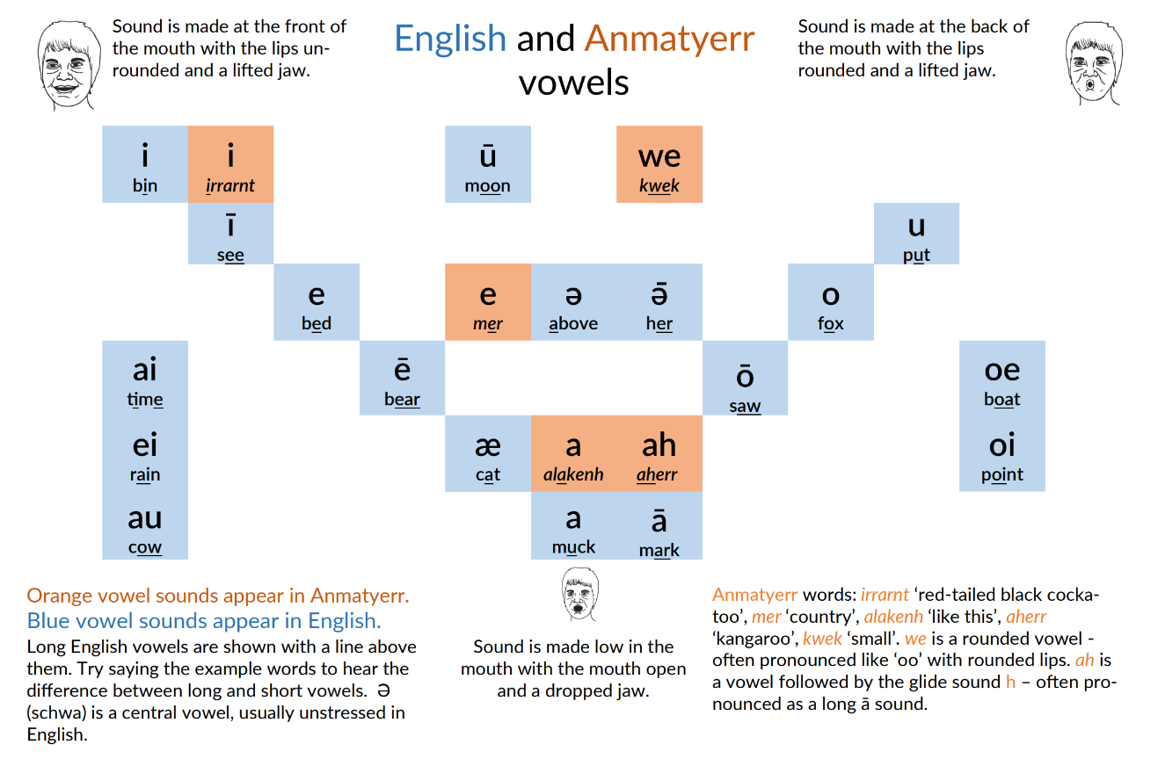
Vowels: a vowel is a sound produced when the air flows more freely through the throat and mouth e.g. a, e, u, i etc.

Slide 13
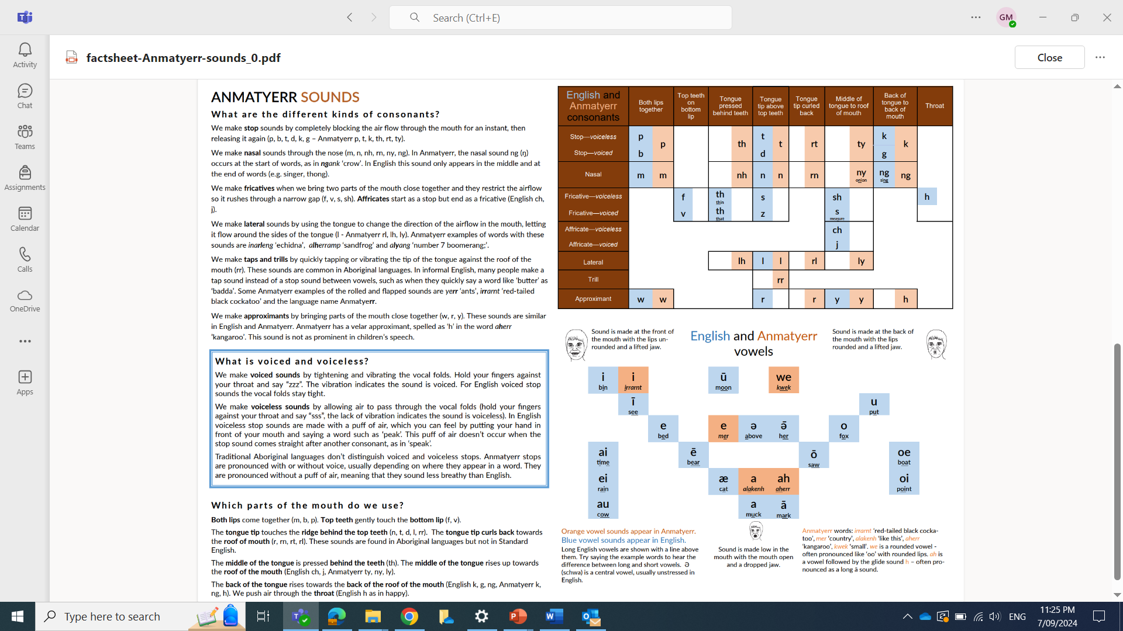
A
Arrernte vowels: a e i u

Slide 14
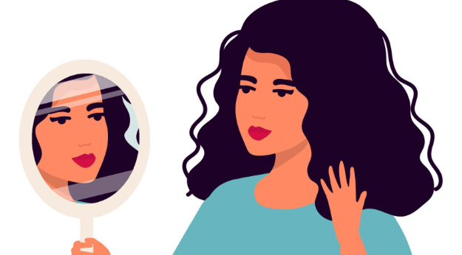
Let's practice Arrernte Sounds
Angkentye awaye!
Listen to the word!
Angkentye awethe angkaye!
  Repeat the word!

Slide 15
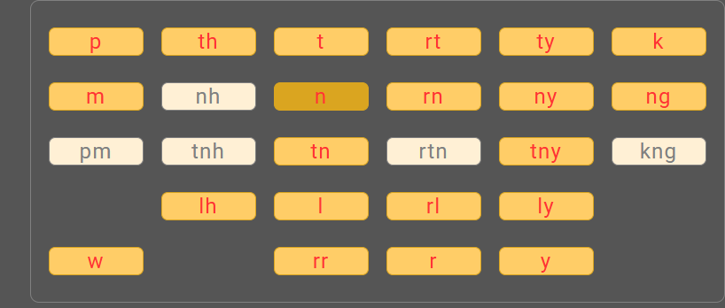
Bilabial | Dental | Alveolar | Retroflex | Palatal | Velar
Stop
Nasal
Pre-stop nasal
lateral
Glide
https://arrernte-angkentye.online/atantheme/default.html

Slide 16
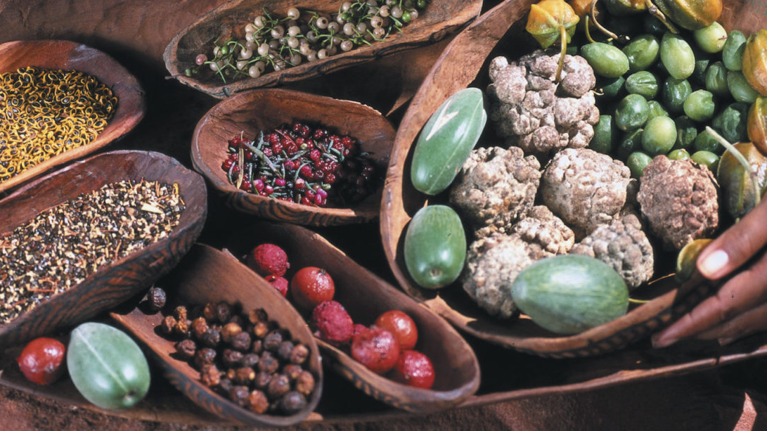
Merne arlkwetye-ke anteme
10:30 – 11:00

Slide 17
Arrerne-alhaye

Slide 18


Ilyelheme
Unte nthenhe-arenye?
Atyenge ilaye, atyenge ilaye. (repeat x2)
Ayenge apmere ikngerrarenye.
Ltyentye Apurte, Ltyentye Apurte.
Unte nthenhe-arenye?
Ltyentye Apurte, Ltyentye Apurte.
Unthenhe-arenye?
Atyenge ilaye, atyenge ilaye
Unte nthenhe-arenye?
Atyenge ilaye, atyenge ilaye.​
​
Ayenge apmere Amoonguna-arenye.​
Apmere nhenhe mwerre anthurre.
Unte nthenhe-arenye?
Amoonguna-arenye, Amoonguna-arenye.
Male voice
Unte nthenhe-arenye?
Atyenge ilaye, atyenge ilaye

Slide 19
Close
Mwerre anthurre angkentye-ke akaltye-irretyeke apetyeke.
Urreke aretye-nhenge!
Arritnye atyinhe _______

